Slide 1

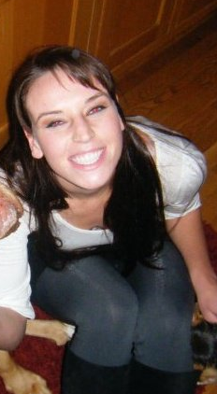
Chelsea Madison Rose
Born in Bakersfield, CA
19 years of age
Will receive a degree in Kinesiology & Performance Psychology
Living the Life she dreamed
Volleyball brings her to New Mexico State University

Slide 2


Further Education
New Mexico State University
  Kinesiology Degree
  Performance Psychology Degree
Masters Program
  Sports Medicine
Doctorate
  Sports Scientist

Slide 3

What the Future Holds
Travel the World, beginning with Europe (2013)
Never putting limitations on what she will achieve
Leave a mark in the world of Sports
Strive to better the ones around her
“If you can dream it, you can do it.”- Walt Disney

Slide 4
CEPA
ESTJ
Enthused, Upbeat, Friendly
Not personally threatened by conflict or criticism
Responsible with day-to-day practical concerns
Takes commitments & relationships seriously
ESFJ
Keen sense of right and wrong
See problems clearly and delegate easily
Work Hard, and play with Zest
At odds with self when it comes to risk and conflict

